Slide 1



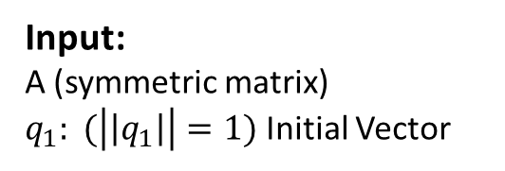

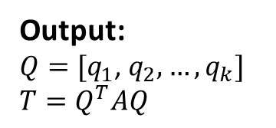




Start
$$j=1$$
$$Q_{j}=q_{j}$$
$$_{j}=q_{j}^{T}Aq_{j}$$
Input:
A (symmetric matrix)
$q_{1}: (\left|\left|q_{1}\right|\right|=1)$ Initial Vector
$$r_{j}=\left(A−α_{j}I\right)q_{j}−β_{j−1}q_{j−1}$$
Output:
$Q=[q_{1}$, $q_{2},…,q_{k}]$
$$T=Q^{T}AQ$$
$$_{j}={|\left|r_{j}\right||}_{2}$$
$$j=j+1$$
$$q_{j}=r_{j−1}/_{j−1}$$
No
$$_{j}=0 ?$$
Yes
End

